Slide 1
Natural Language Processing (NLP)
with Deep NLP
AMIT DHOMNE
Computer Science Instructor
Machine Learning and Deep learning Practitioner

Slide 2
Prerequisite
for
Natural language processing
Python
Basic Concept of Machine Learning and Deep Learning

Slide 3
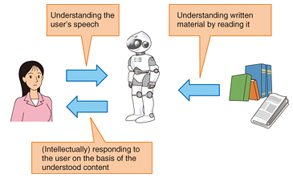
Natural language processing

Slide 4
Natural language processing
Natural language processing (NLP) is a subfield of linguistics, computer science, information engineering, and artificial intelligence concerned with the interactions between computers and human (natural) languages, in particular how to program computers to process and analyze large amounts of natural language data.
Challenges in natural language processing frequently involve speech recognition, natural language understanding, and natural language generation.

Slide 5
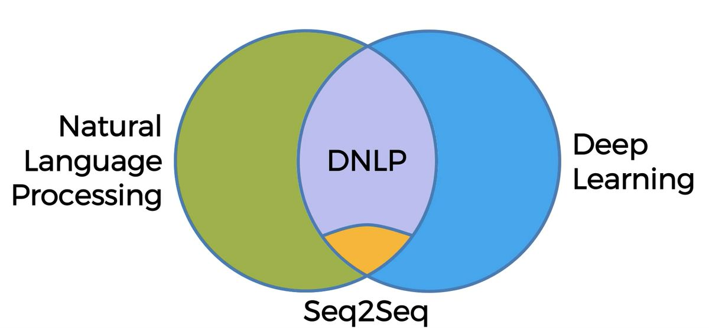
Types of NLP

Slide 6
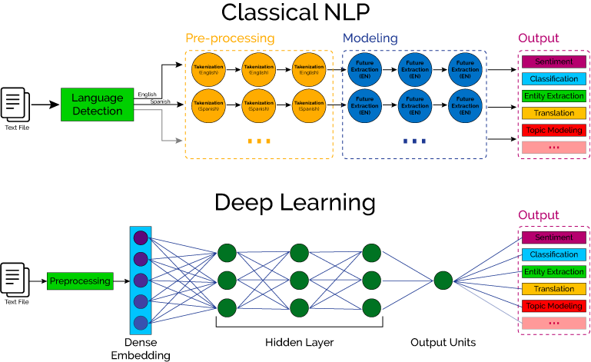

Slide 7
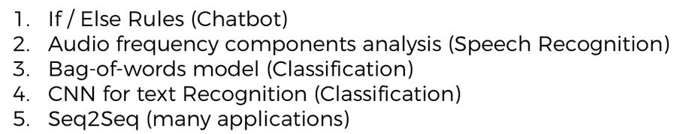
How NLP, DNLP and DL involves in!!!
s

Slide 8
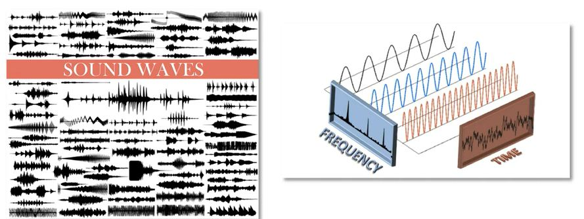
How NLP, DNLP and DL involves in!!!

Slide 9
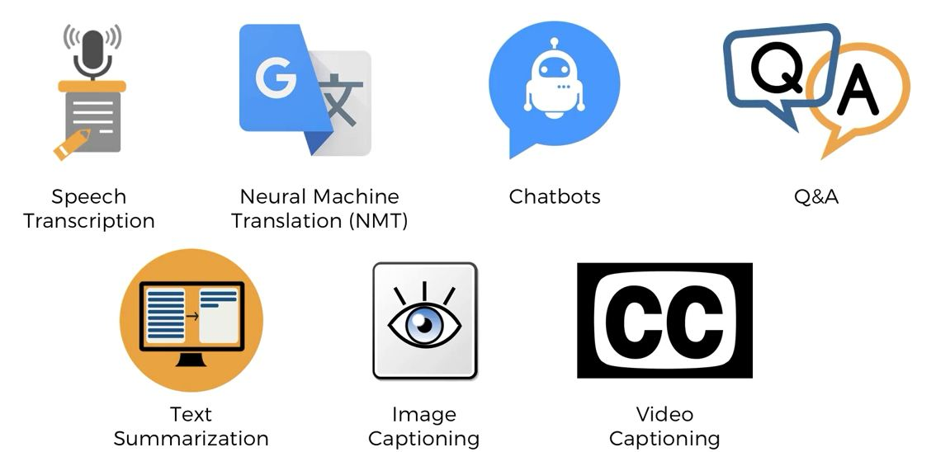
Applications

Slide 10
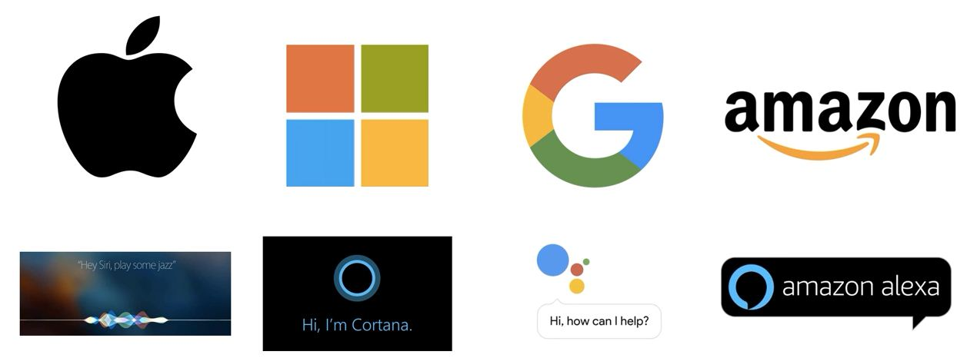
Used by

Slide 11
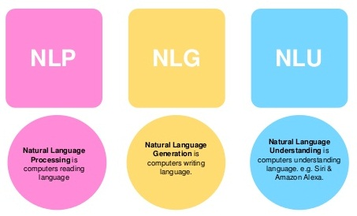
NLP Working

Slide 12
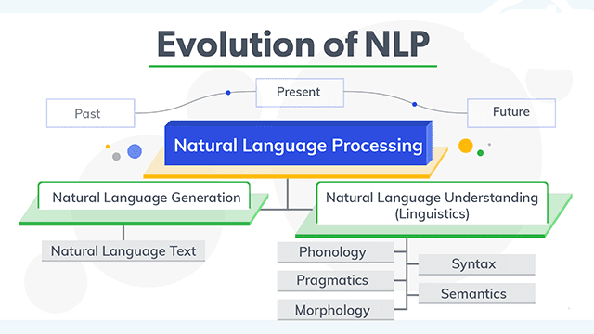
NLP Working

Slide 13
Natural Language Understanding
Ambiguity:
Lexical Ambiguity : The Tank is full of water.
Syntactic Ambiguity : ill men and women get to hospital.
Semantic Ambiguity : The Bike hit the pole while it was running.
Pragmatic Ambiguity : The Army is coming.
Phonology – This science helps to deal with patterns present in the sound and speeches related to the sound as a physical entity.
Pragmatics – This science studies the different uses of language.
Morphology – This science deals with the structure of the words and the systematic relations between them.
Syntax – This science deal with the structure of the sentences.
Semantics – This science deals with the literal meaning of the words, phrases as well as sentences.
For further assistance, code and slide https://fahadhussaincs.blogspot.com/
YouTube Channel: https://www.youtube.com/channel/UCapJpINJKHzflWwCQ8Kse2g/playlists

Slide 14
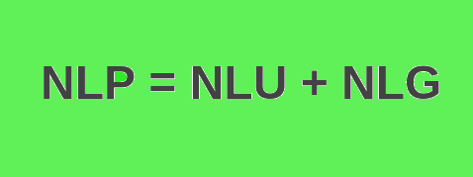

Natural Language Generation
Based on NL-Understanding, it will suggest about:
What should say to user.
Should be Intelligent and Covervational as like human
Usage of Structured data.
With text and Sentence like planning.
For further assistance, code and slide https://fahadhussaincs.blogspot.com/
YouTube Channel: https://www.youtube.com/channel/UCapJpINJKHzflWwCQ8Kse2g/playlists

Slide 16
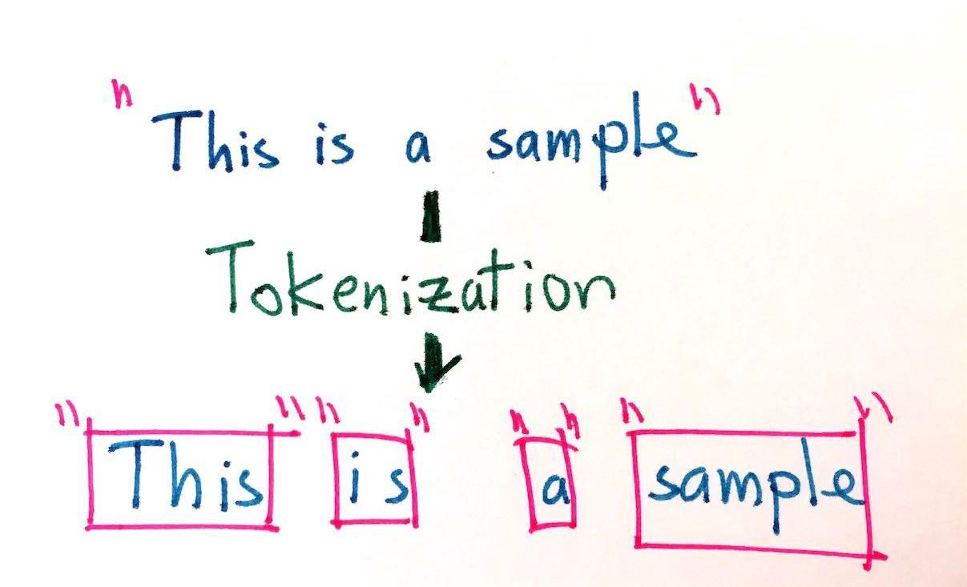
Tokenization
Tokenization is the process of replacing sensitive data with unique identification symbols that retain all the essential information about the data without compromising its security.

Slide 17
Tokenization
There are many library / framework for NLP problem solution
1. Natural Language Toolkit (NLTK)
2. TextBlob
3. CoreNLP
4. Gensim
5. spaCy
6. polyglot
7. scikit–learn
8. Pattern
...

Slide 18
Stemming and Lemmatization
Before understanding Stemming and Lemmatization, first let’s understand the following…
Prefix: Character(s) at the beginning ▸ $ ( “ ¿
Suffix: Character(s) at the end ▸ km ) , . ! ”
Infix: Character(s) in between ▸ - -- / ...
Exception: Special-case rule to split a string into several tokens or prevent a token from being split when punctuation rules are applied St. U.S.

Slide 19
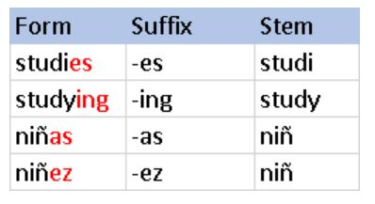
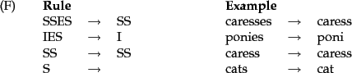
Stemming
Stemming is the process of reducing a word to its word stem that affixes to suffixes and prefixes or to the roots of words known as a lemma. Stemming is important in natural language understanding (NLU) and natural language processing (NLP).

Slide 20
Porter Stemming
One of the most common - and effective - stemming tools is Porter's Algorithm developed by Martin Porter in 1980. The algorithm employs five phases of word reduction, each with its own set of mapping rules
e.g: caresses reduces to caress but not cares

Slide 21
Snowball Stemming
Snowball is a small string processing language designed for creating stemming algorithms for use in Information Retrieval. This site describes Snowball, and presents several useful stemmers which have been implemented using it
Useful link for additional reading...
https://nlp.stanford.edu/IR-book/html/htmledition/stemming-and-lemmatization-1.html

Slide 22
Lemmatization
Lemmatization usually refers to doing things properly with the use of a vocabulary and morphological analysis of words, normally aiming to remove inflectional endings only and to return the base or dictionary form of a word, which is known as the lemma .
The lemma of 'was' is 'be' and the lemma of 'mice' is 'mouse’.
Further, the lemma of 'meeting' might be 'meet' or 'meeting’
depending on its use in a sentence.

Slide 23
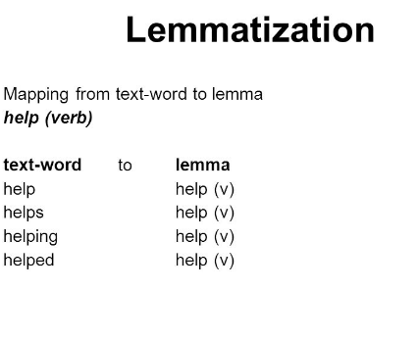
Lemmatization
https://nlp.stanford.edu/IR-book/html/htmledition/stemming-and-lemmatization-1.html

Slide 24
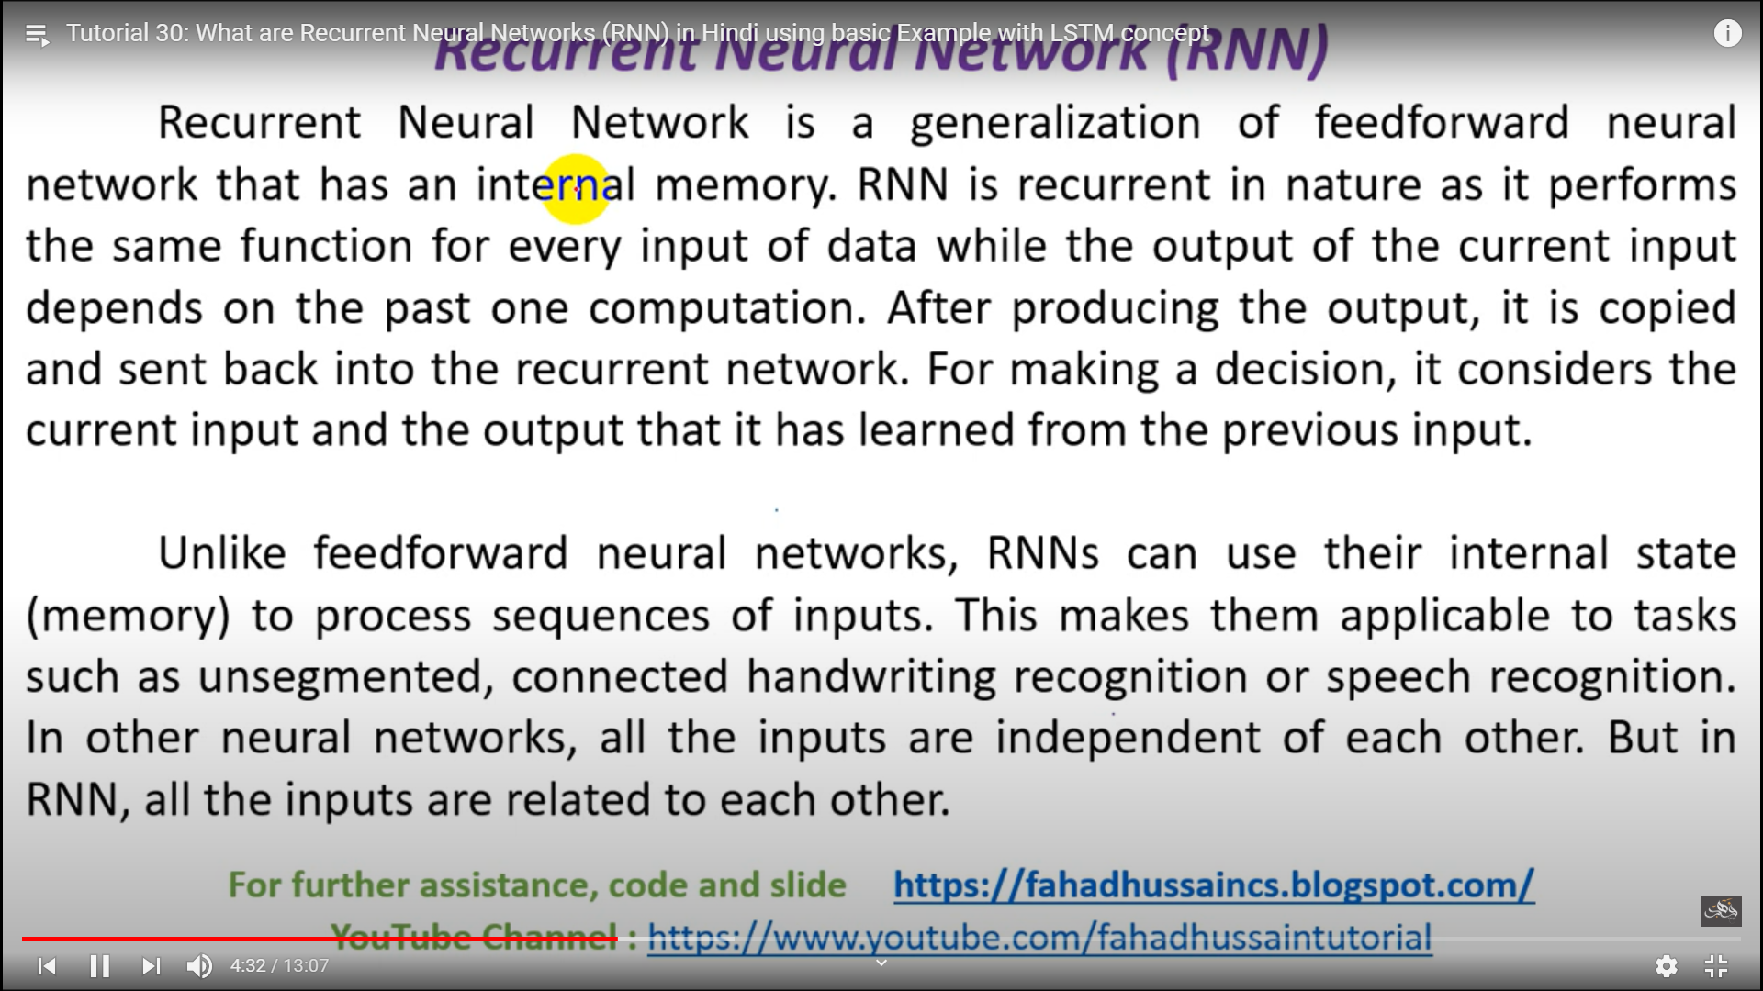
Recurrent Neural Network

Slide 25
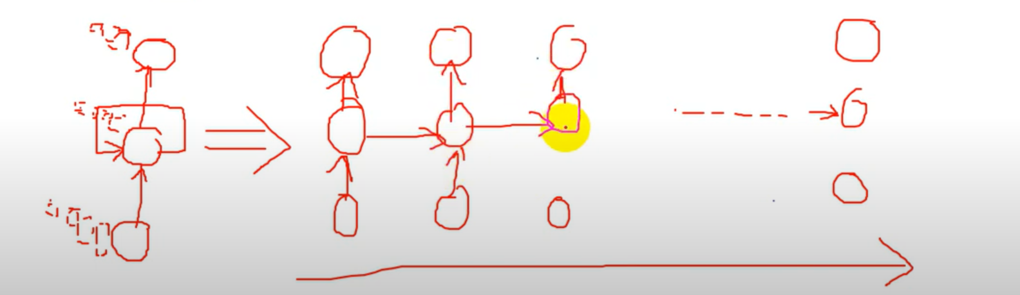

Slide 26
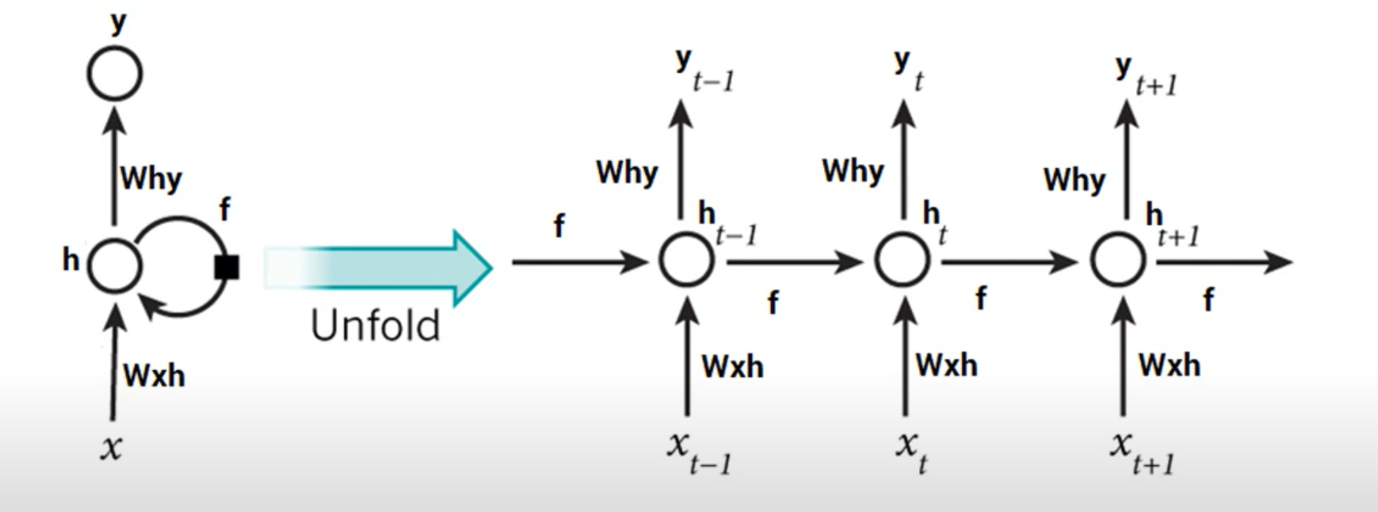

Slide 27
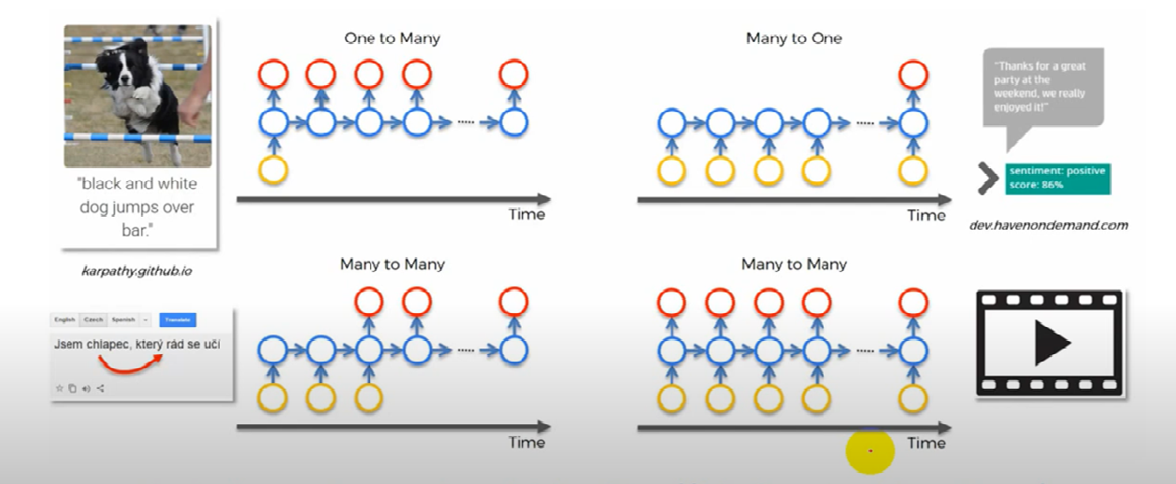
Types of RNN

Slide 28
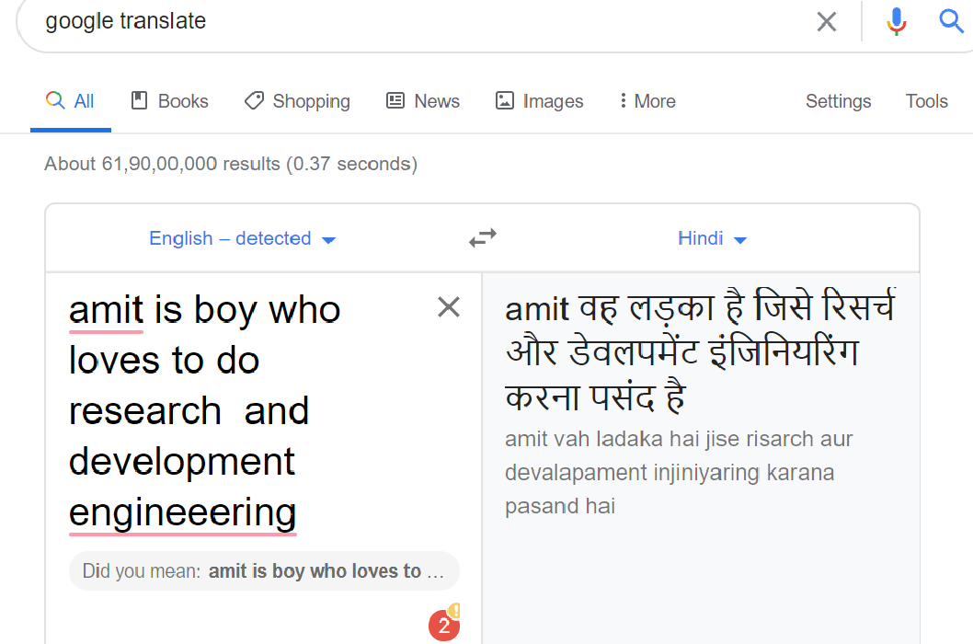

Slide 29
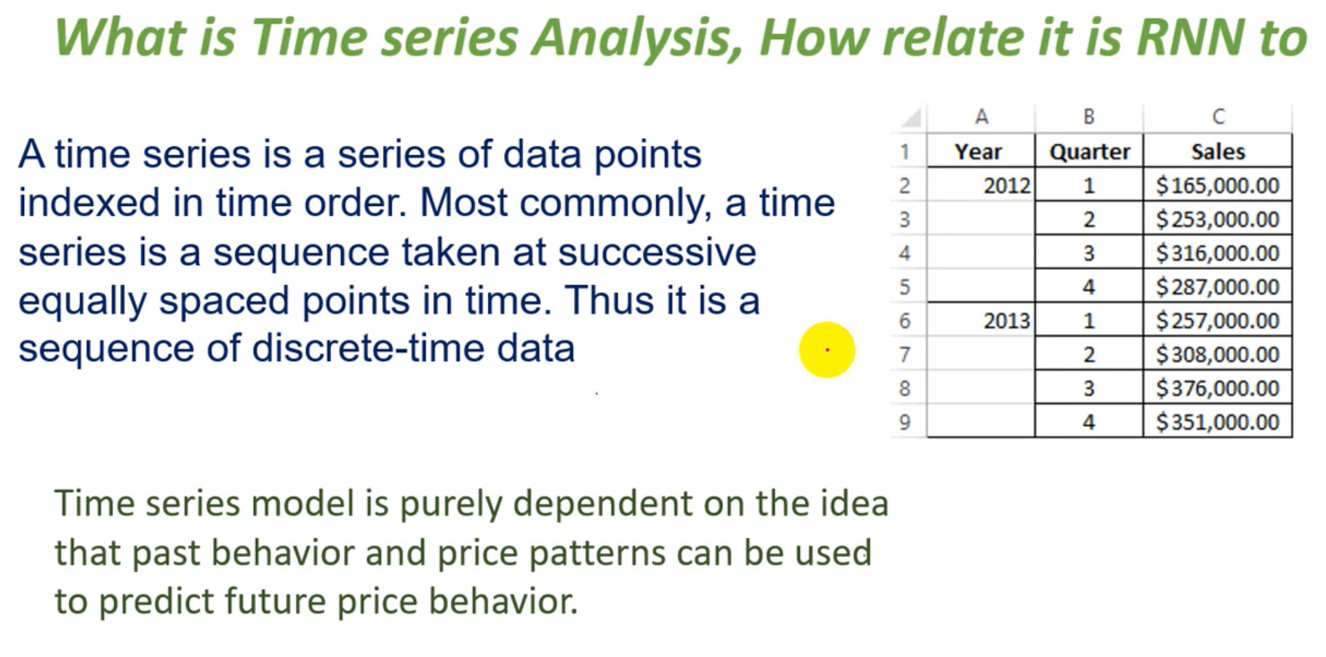

Slide 30
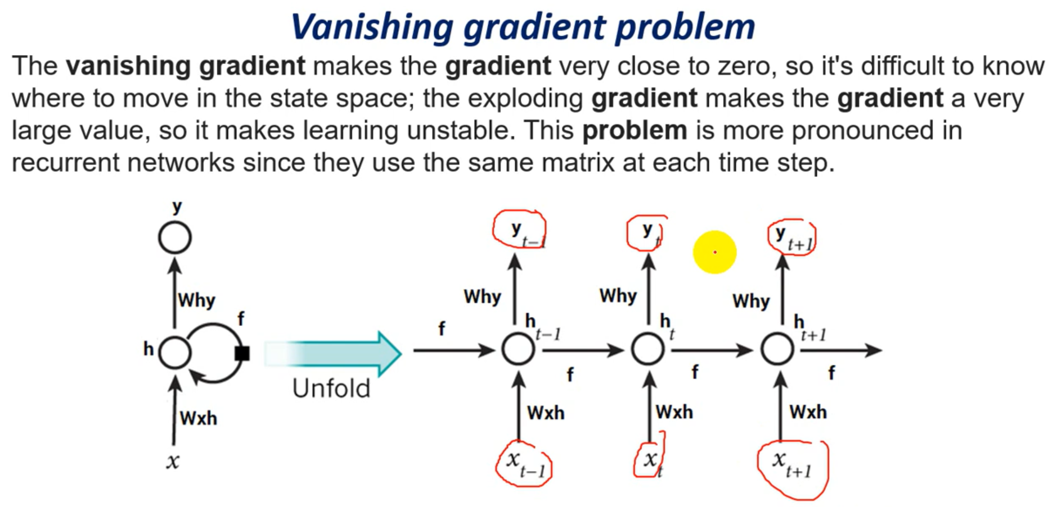

Slide 31
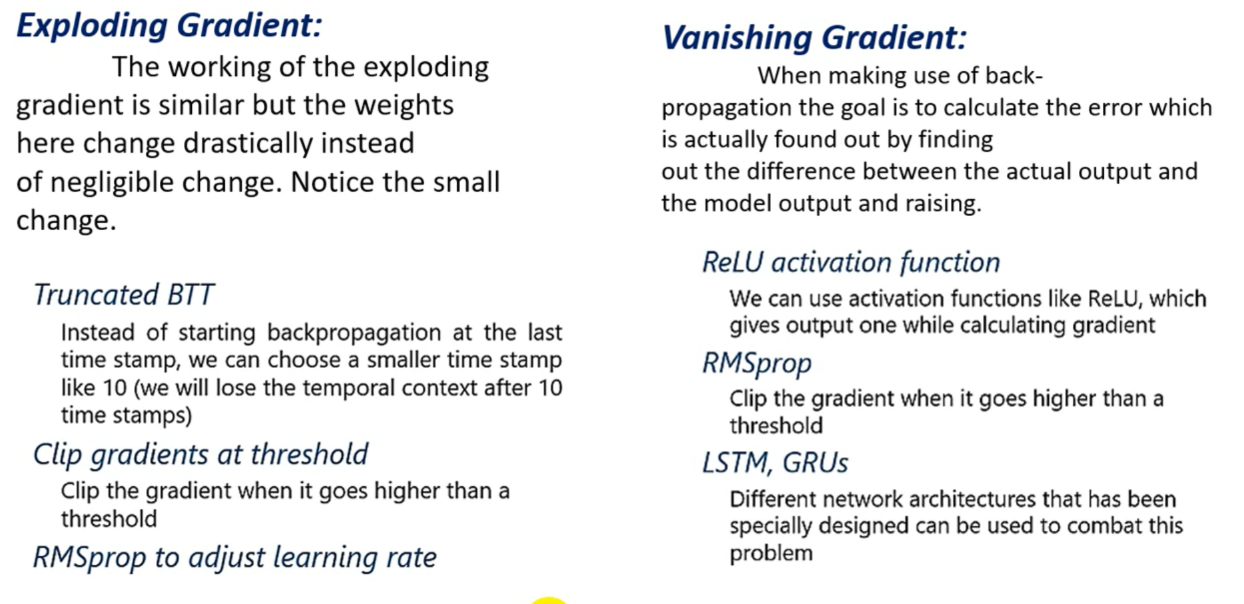

Slide 32
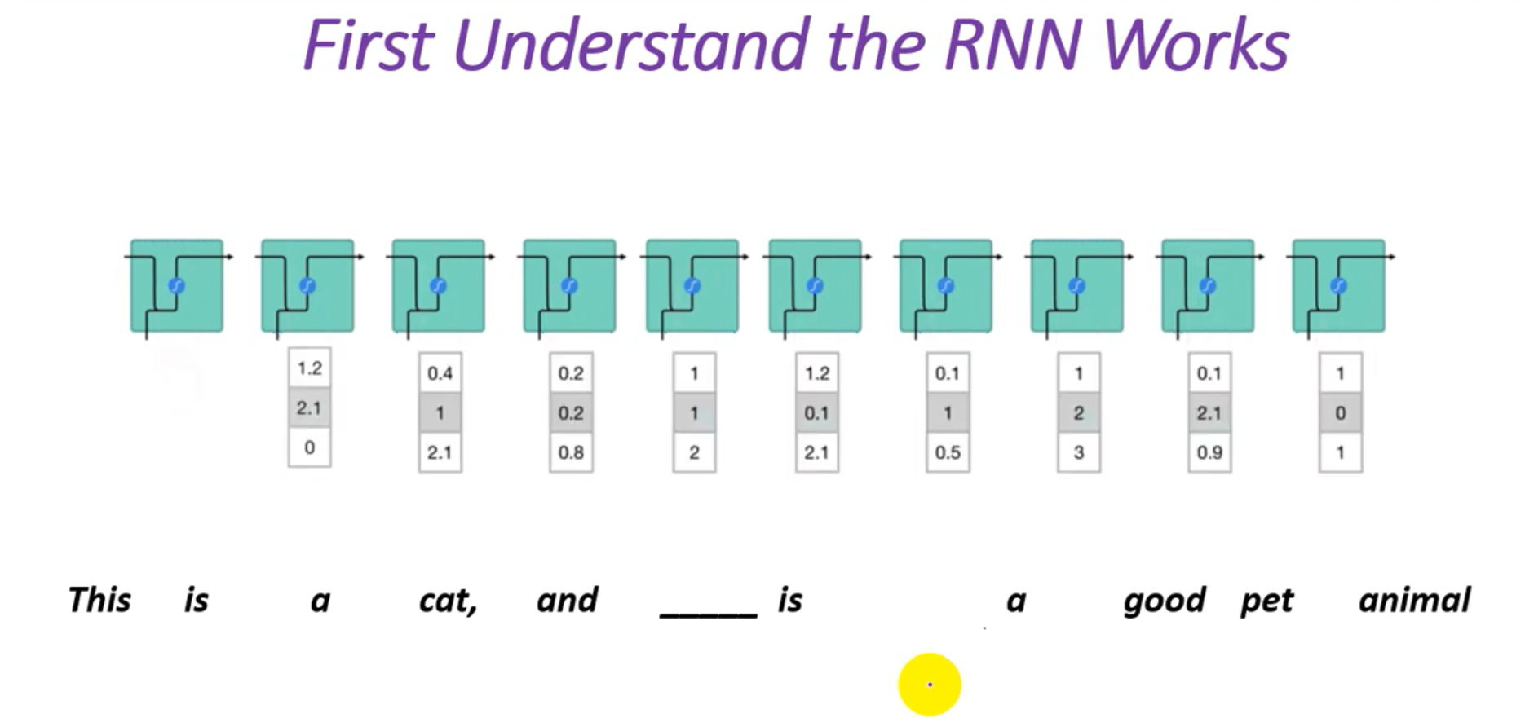

Slide 33
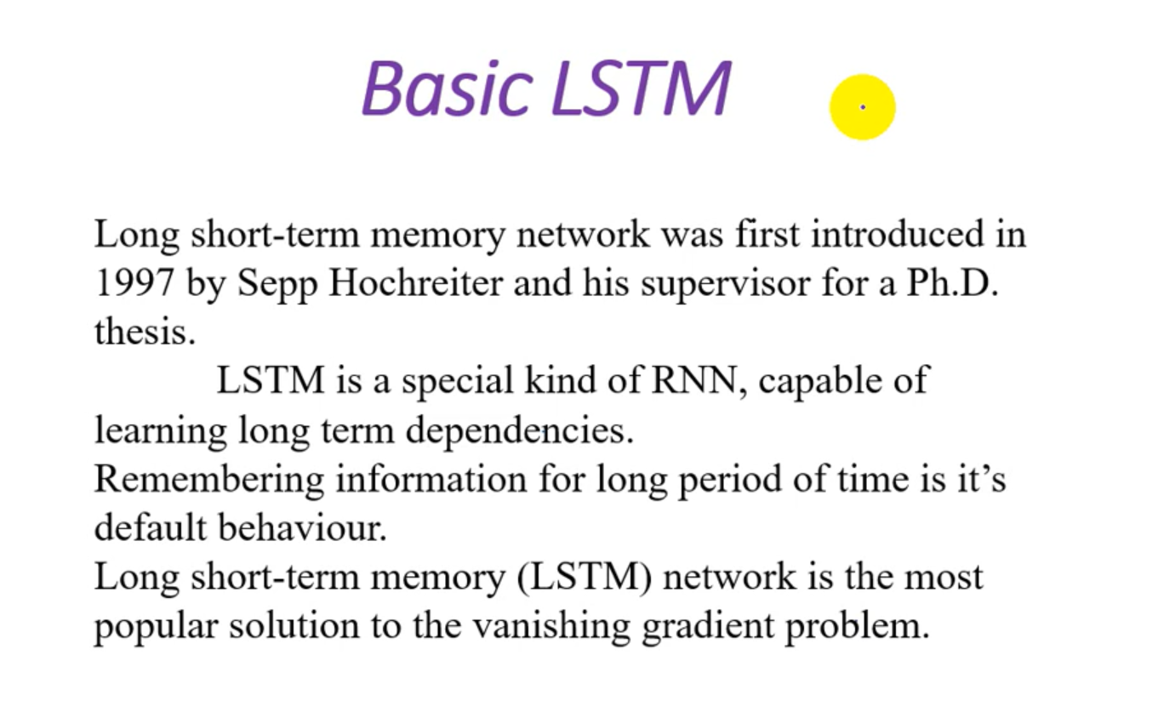

Slide 34
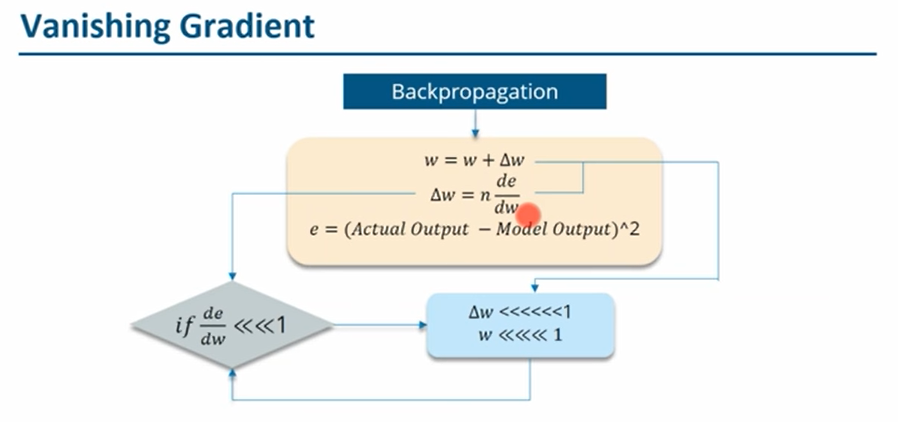

Slide 35
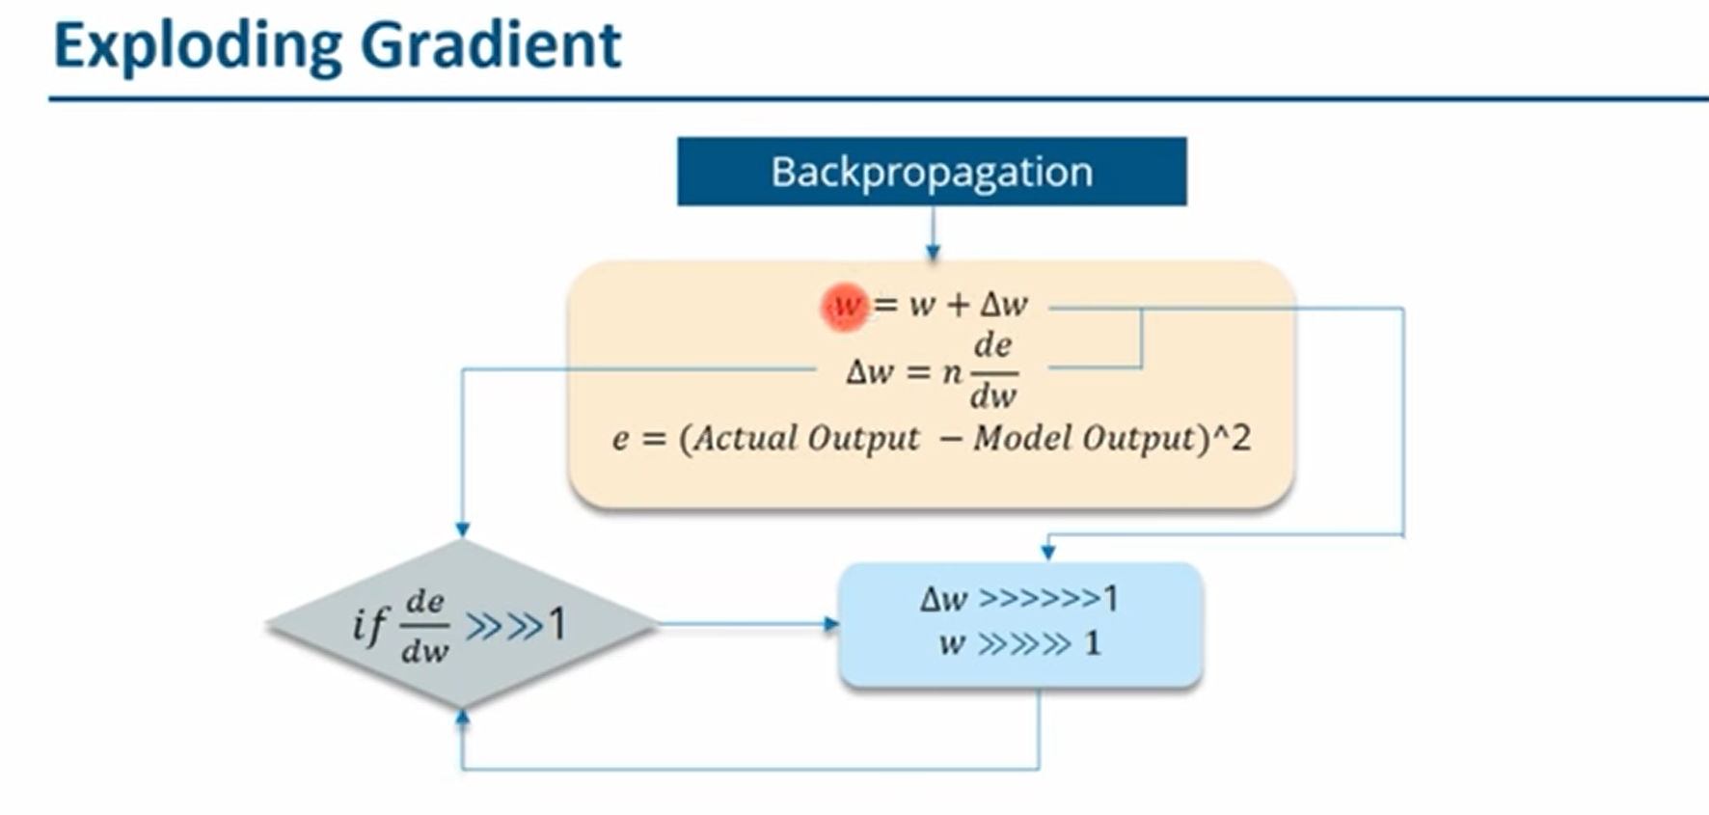

Slide 36
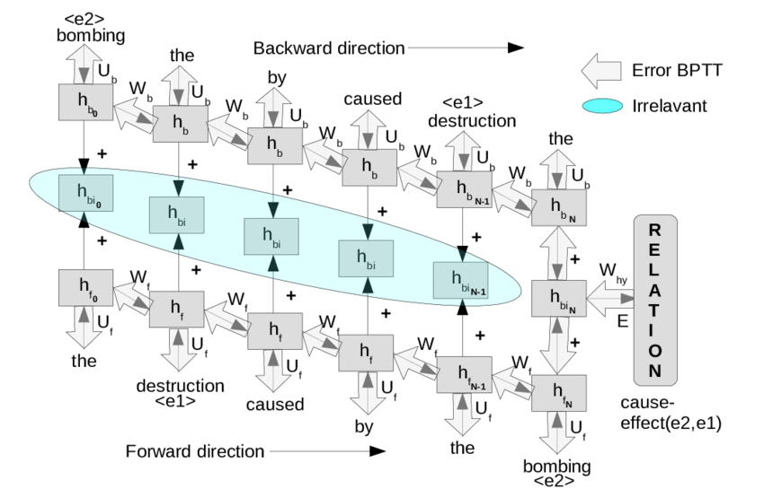
Back Propagation Through Time(BTT) : Backpropagation through time is a gradient-based technique for training certain types of recurrent neural networks.

Slide 37
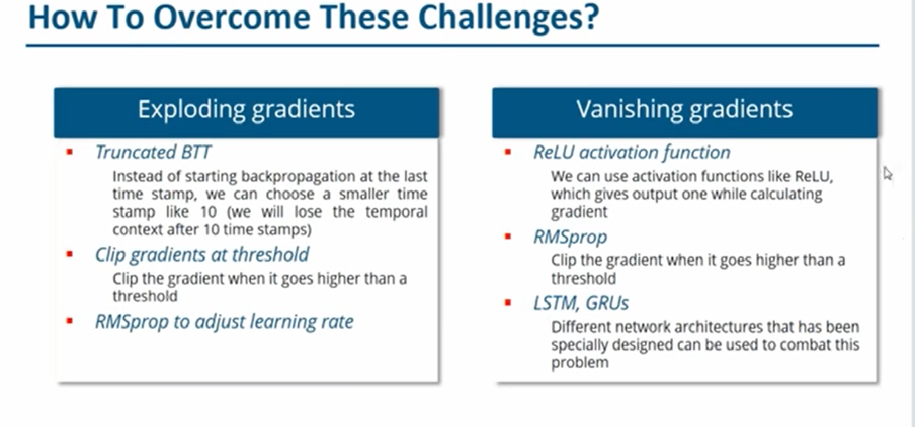

Slide 38
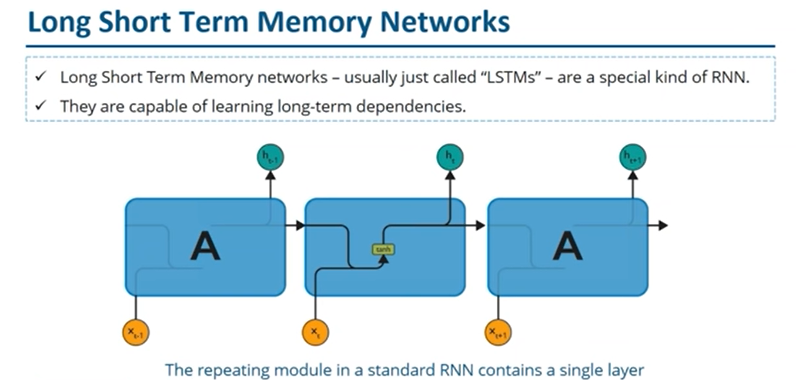

Slide 39
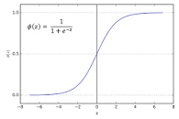
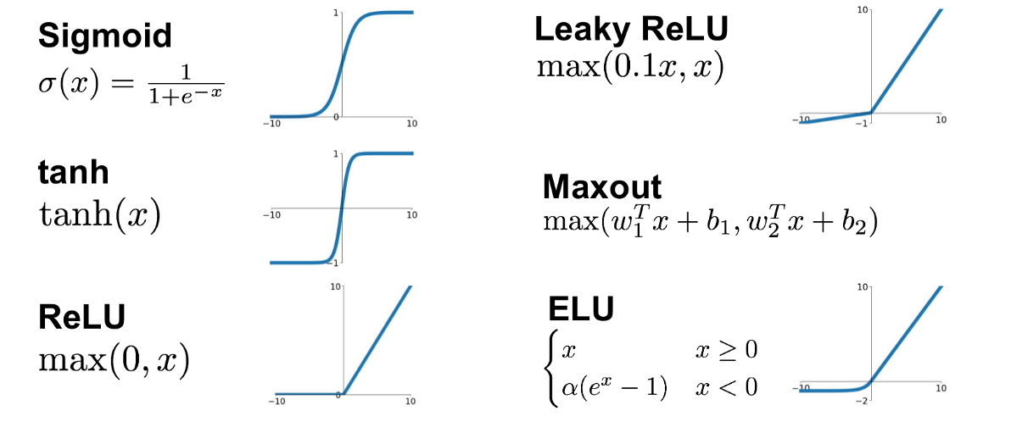
Sigmoid : -The sigmoid activation function, also called the logistic function, is traditionally a very popular activation function for neural networks. The input to the function is transformed into a value between 0.0 and 1.0
Tanh :The range of the tanh function is from (-1 to 1)

Slide 40
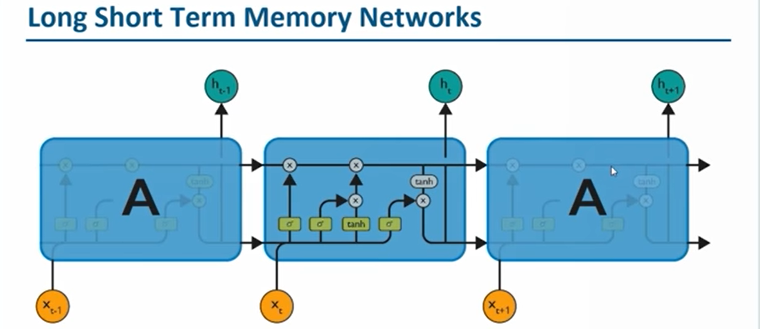

Slide 41
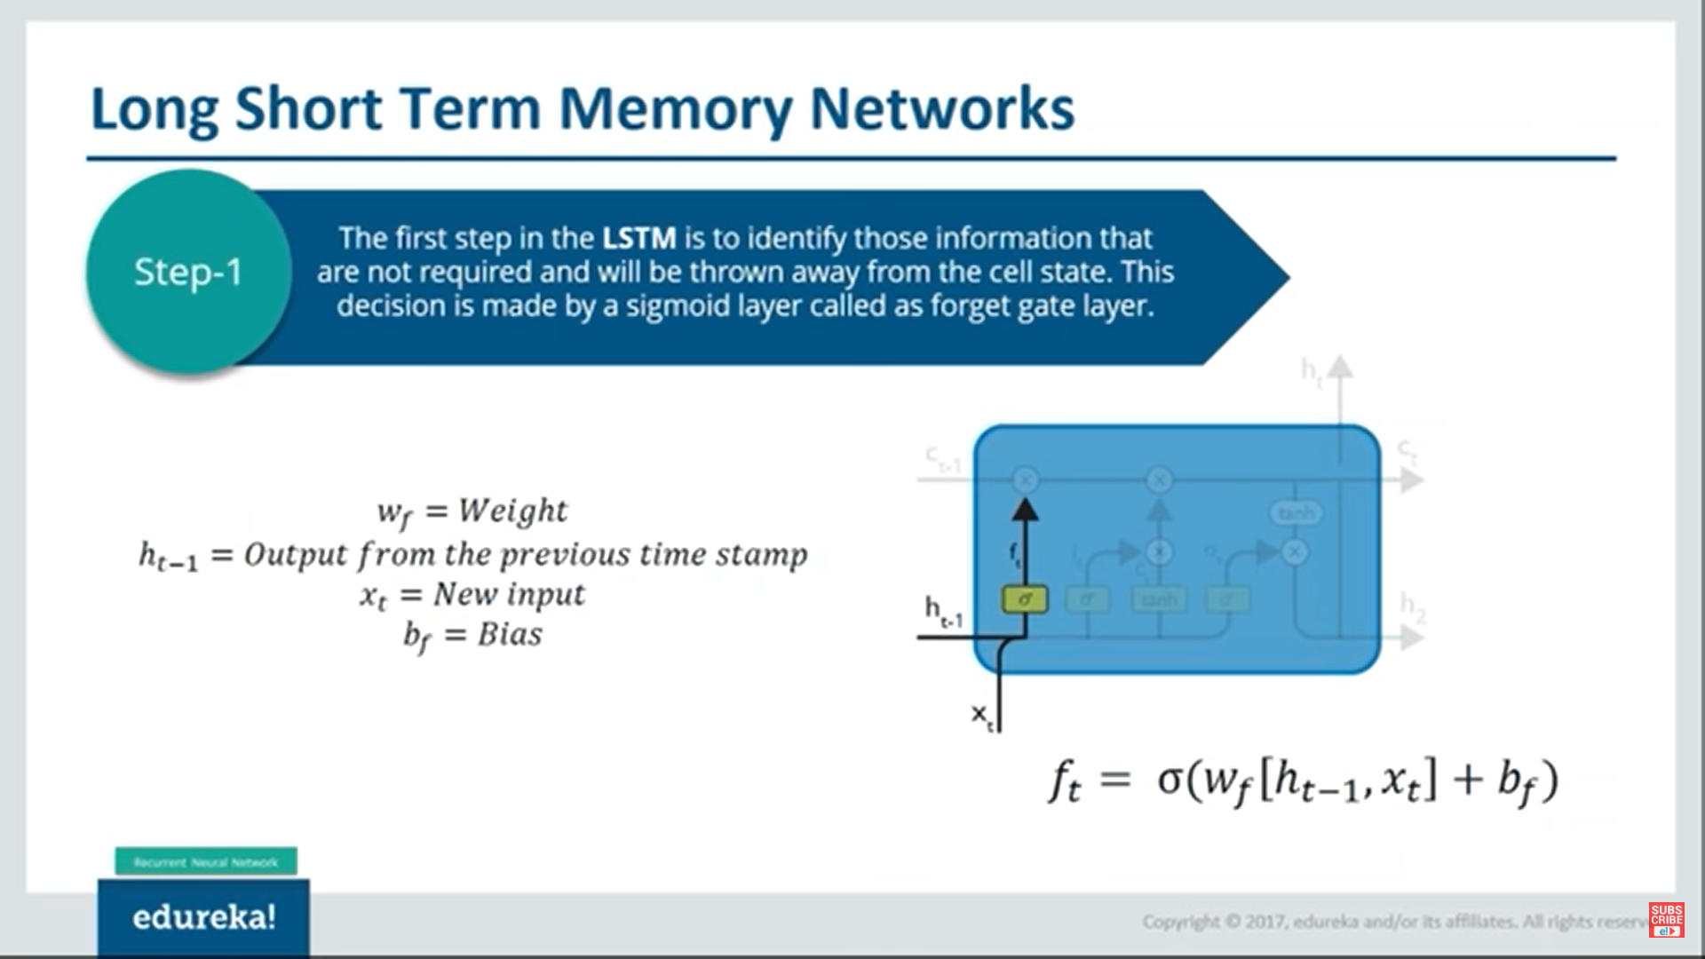

Slide 42
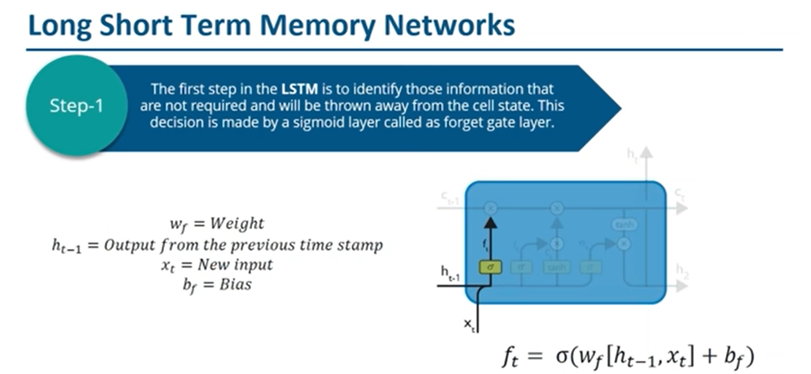

Slide 43
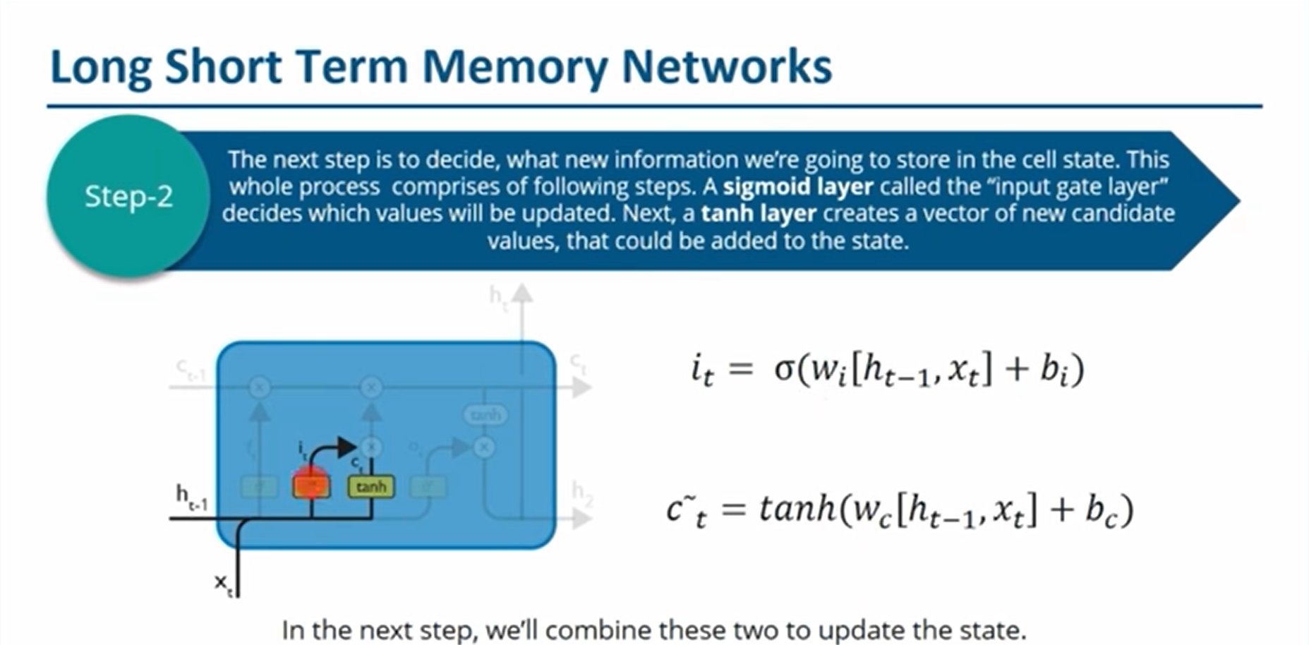

Slide 44
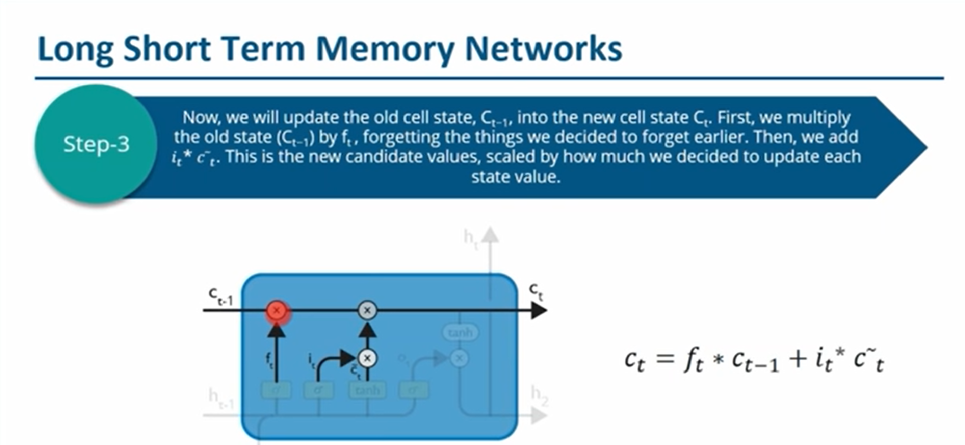

Slide 45
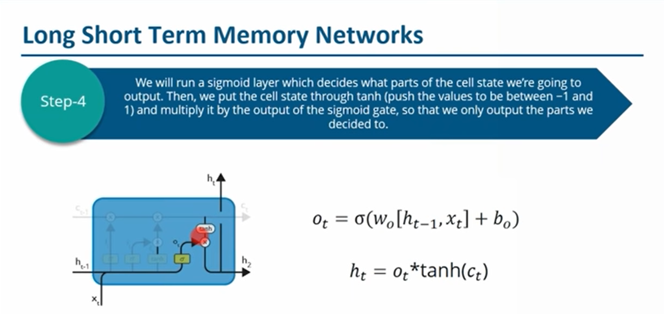

Slide 46
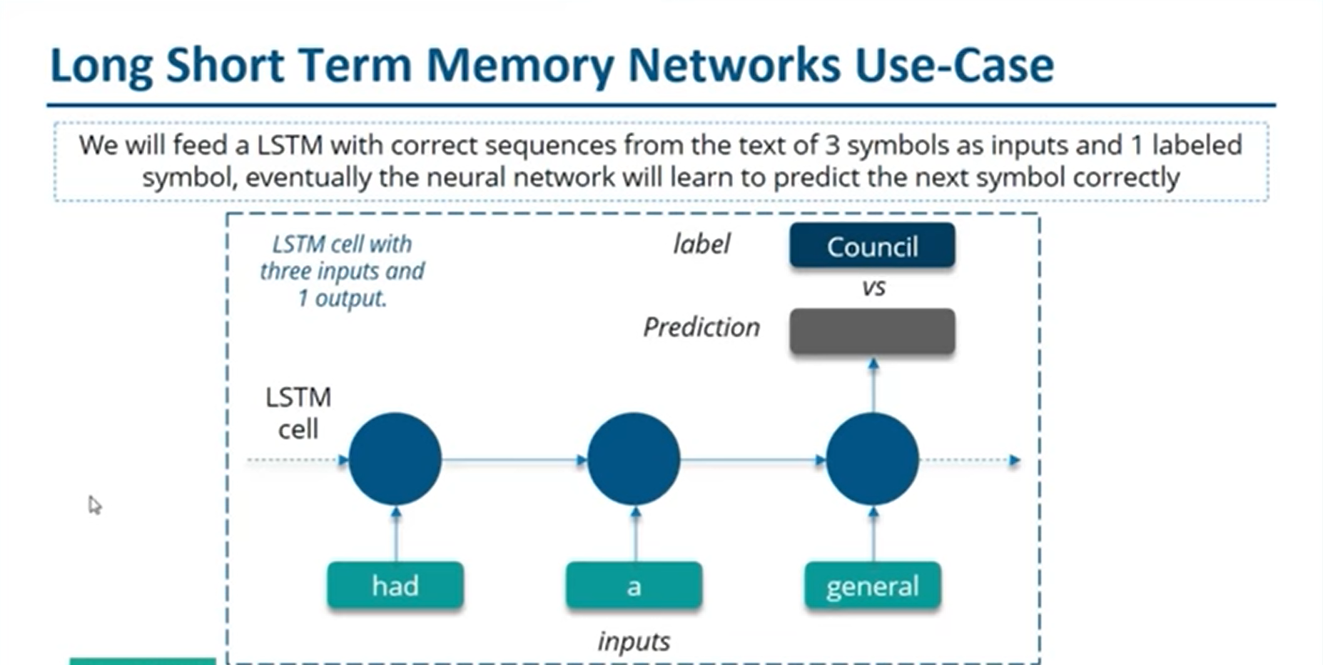

Slide 47
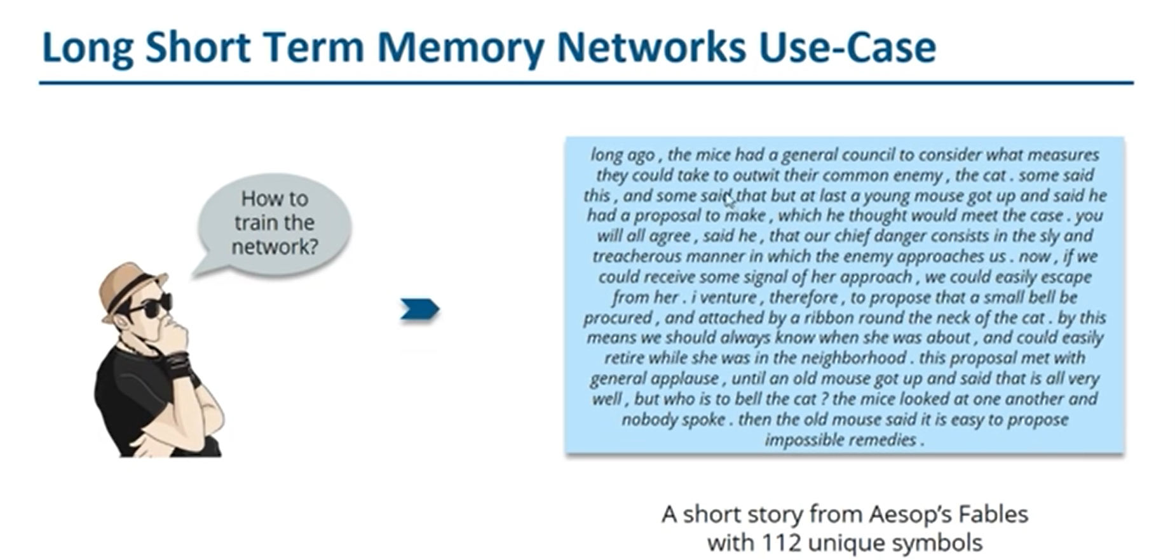

Slide 48
